Slide 1
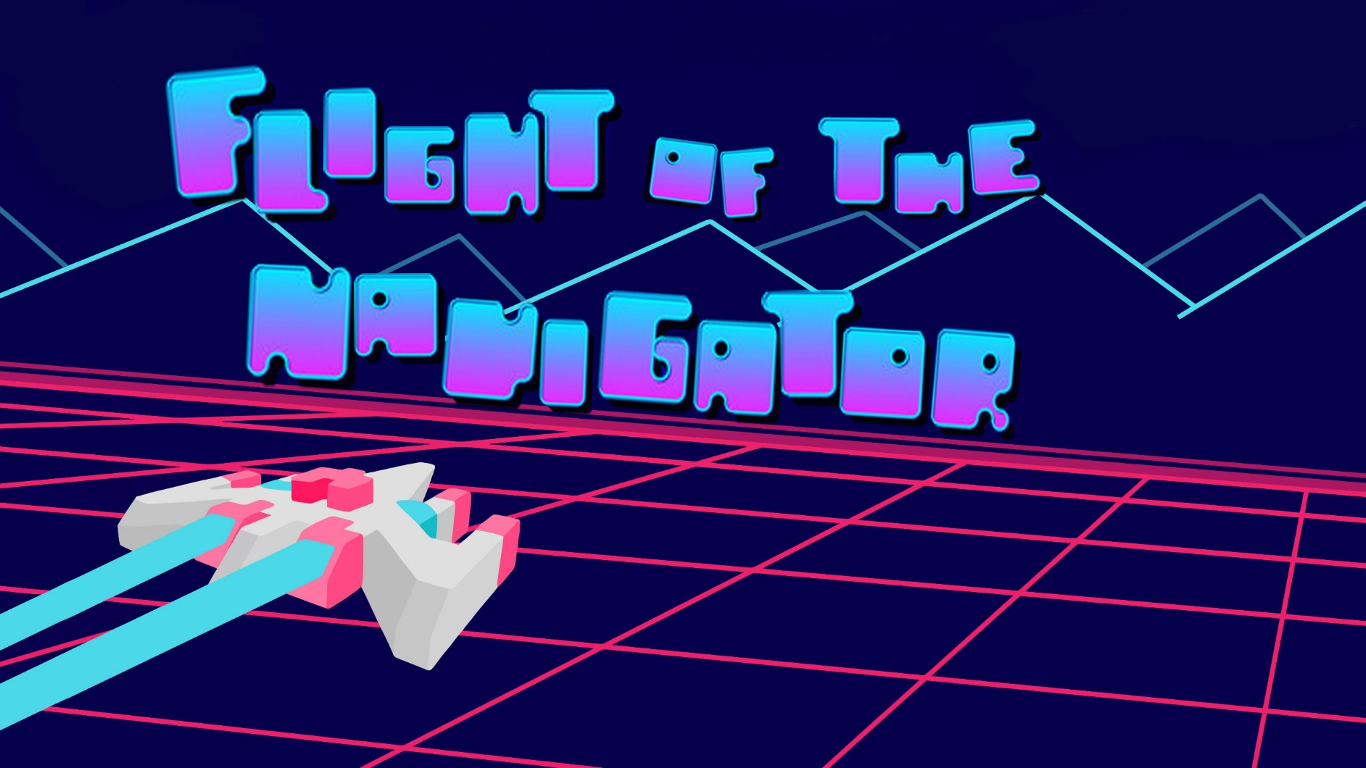

Slide 2
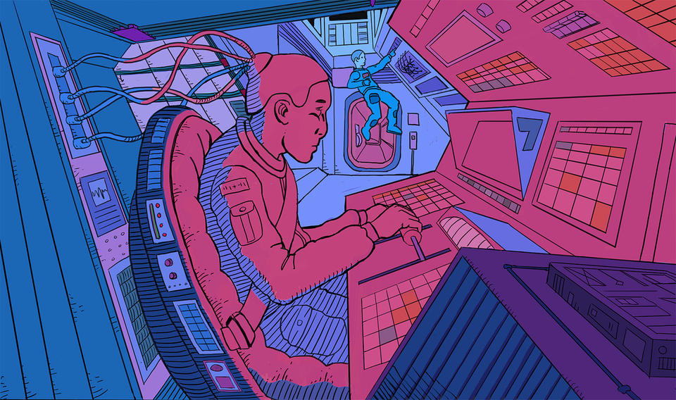
I.Project description

Slide 3

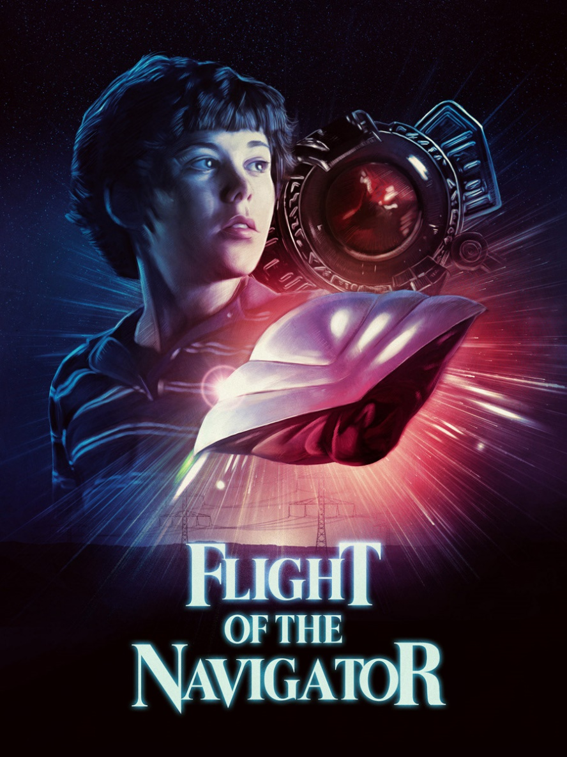
Story and concept based on:
This 1978 Disney adventure tells the story of 12-year-old David (Joey Cramer) who lives with his family in Fort Lauderdale, Fla. When he awakens from being accidentally knocked out in the forest near his home, he finds that eight years have passed. His family is overjoyed to have him back, but just as perplexed as he is by the fact that he hasn't aged. When a NASA scientist (Howard Hesseman) discovers a UFO nearby, David gets the chance to unravel the mystery and recover the life he lost.

Slide 4
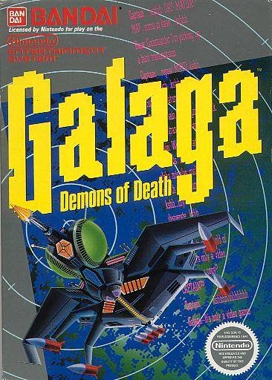
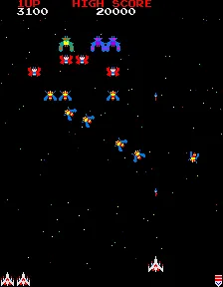
Algorithm and gameplay based on:
Galaga is a 1981 fixed shooter arcade game developed and published by Namco. In North America, it was released by Midway Games. Controlling a starship, the player is tasked with destroying the Galaga forces in each stage while avoiding enemies and projectiles.

Slide 5
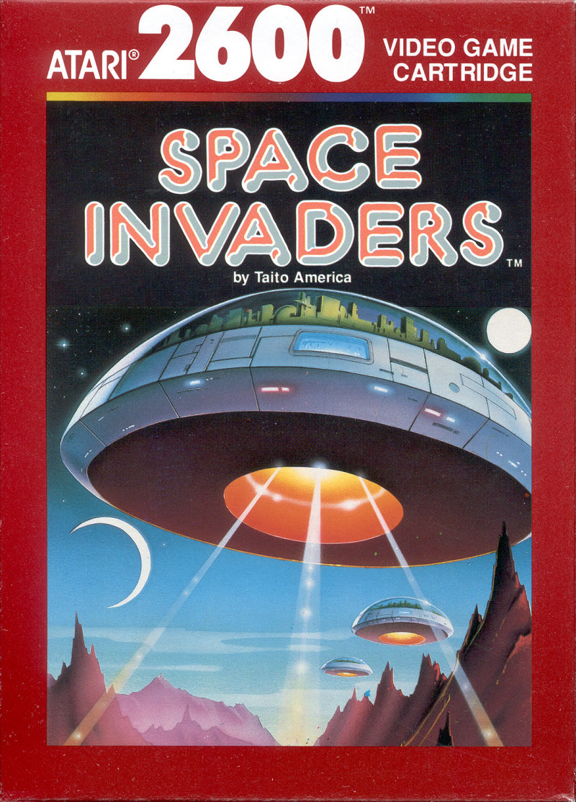
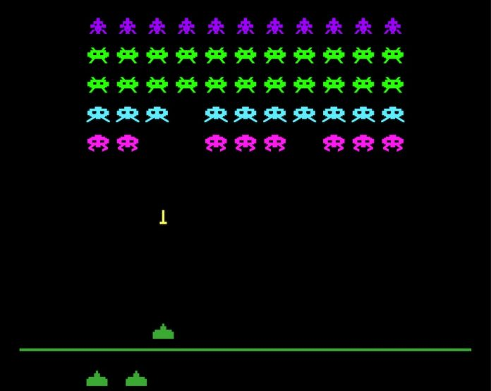
Algorithm and gameplay based on:
Space Invaders is a 1978 arcade game created by Tomohiro Nishikado. It was manufactured and sold by Taito in Japan, and licensed in the United States by the Midway division of Bally. Within the shooter genre, Space Invaders was the first fixed shooter and set the template for the shoot 'em up genre

Slide 6
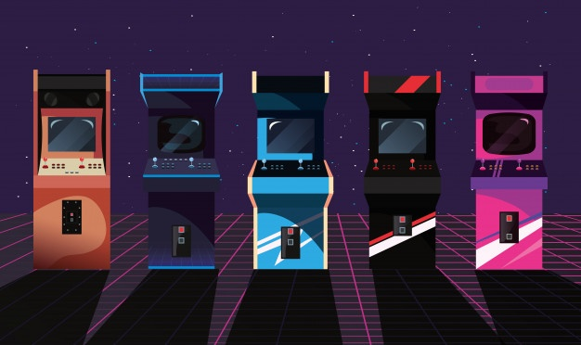

Ii.Game description

Slide 7

Flight of the navigator
It is a mission of a kid who is lost inside an arcade machine.
For him to get back to his real life, he needs to finish his flight as a navigator in defeating his enemies by using ray guns. The goal of this game is for the user to control the spaceship to defeat all the enemies. As the level increases. The enemies will come after the user as fast as they can and will encounter three(3) levels of boss fights. The user should finish the game or else the kid will stay and wait for another mission to pass.

Slide 8
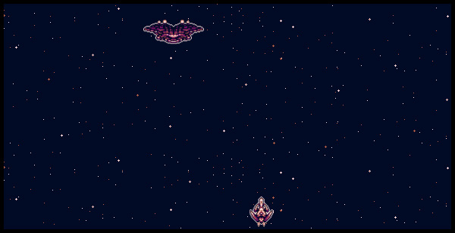






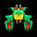


Spaceship
Bosses
The spaceship, this character is used to defeat it’s opponents
Boss1
Boss2
Boss3
Aliens
Each level will encounter different kinds of bosses after they defeat all the aliens. After the user defeats the Bosses. The user will encounter another level of Boss fights. The Final Boss
These aliens will have the role to distract the user before it gets to the Boss

Slide 9
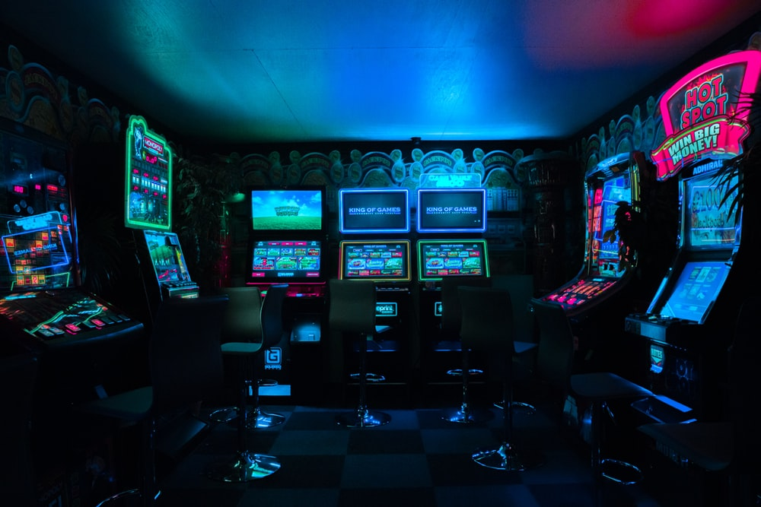

III. GamePlay

Slide 10
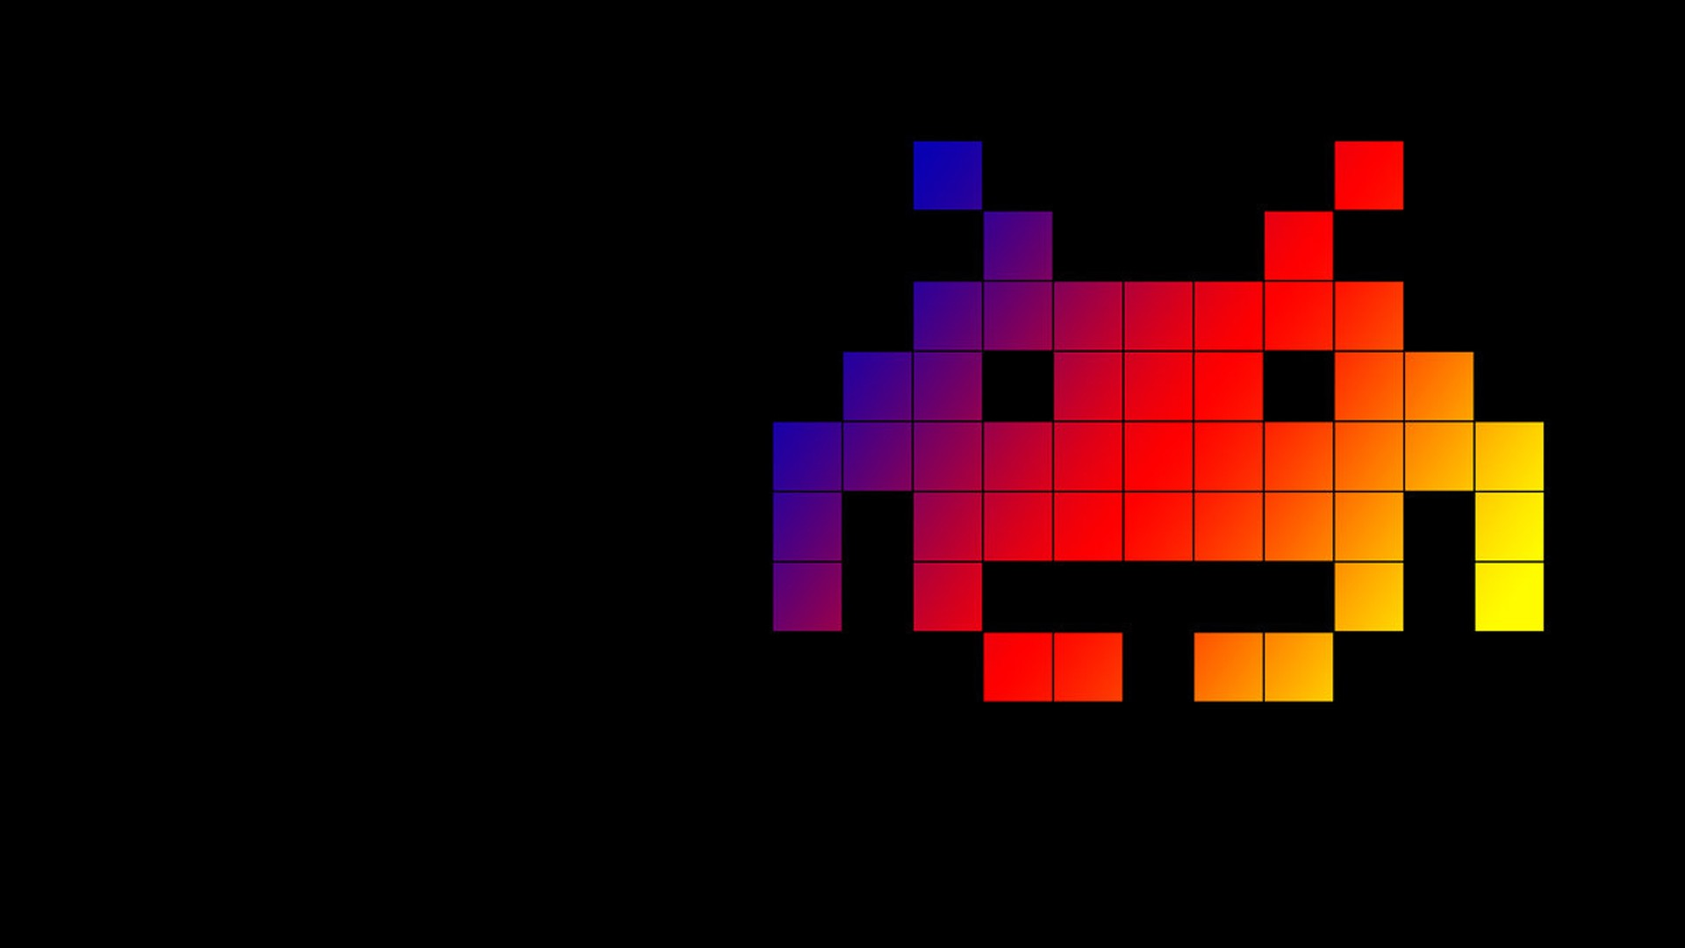

Arrow Keys
These arrow keys will control the spaceship. Used to right and left to avoid the enemies attack. And Up and Down keys if the user wants to get close and to keep away from the enemies

Slide 11

Spacebar
Spacebar is to control the attack of the user

Slide 12
Significant codes

Slide 13
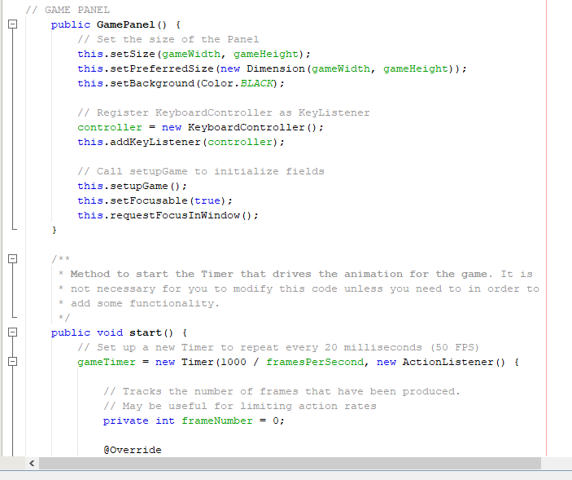
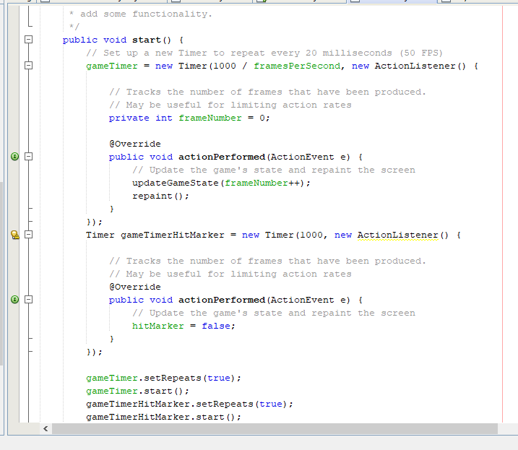
GAME PANEL

Slide 14
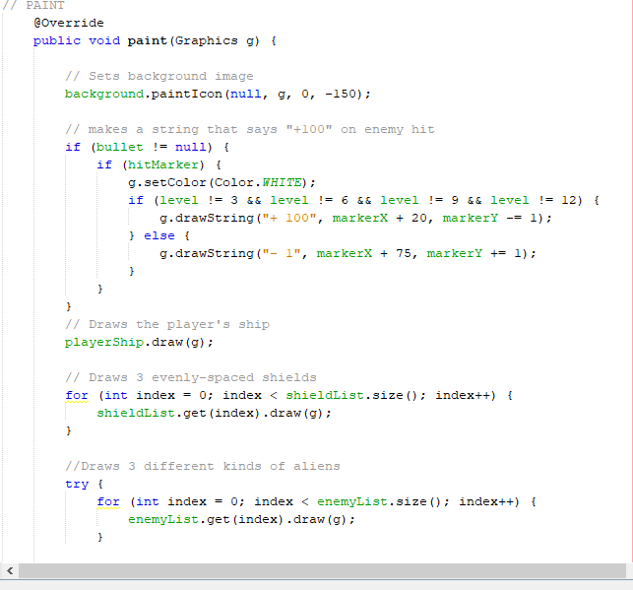
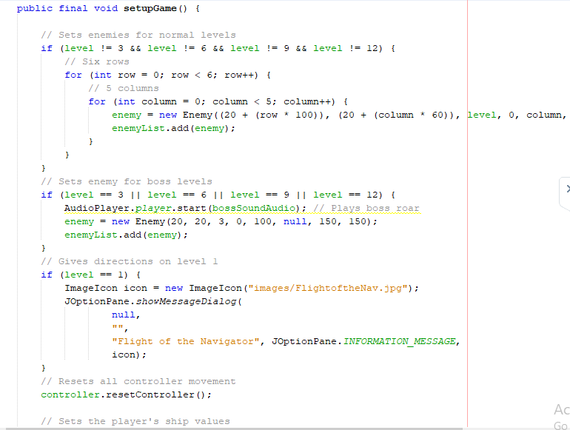
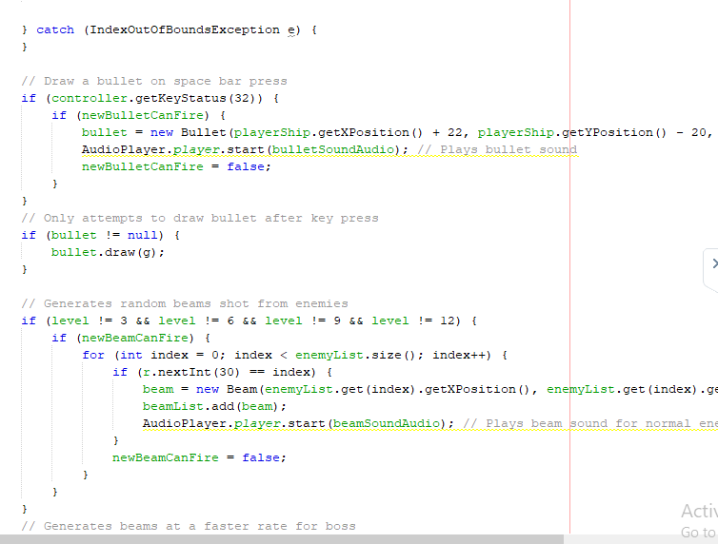
Play State

Slide 15
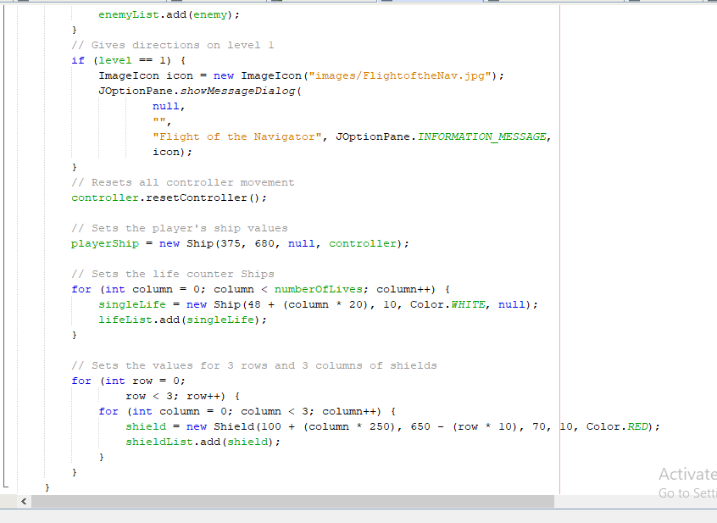
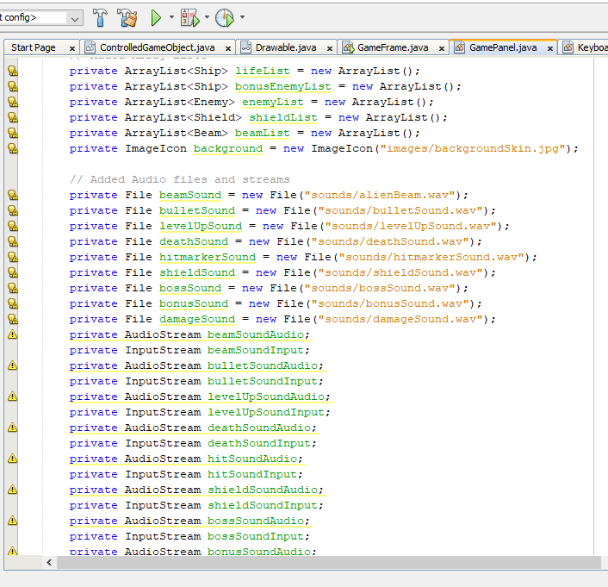
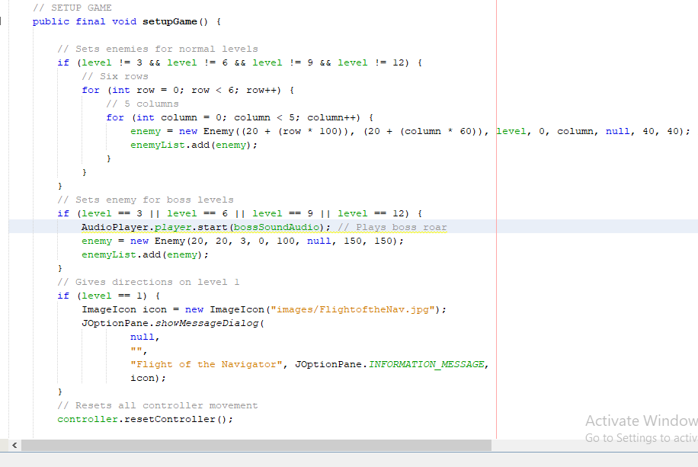
CONTENT

Slide 16
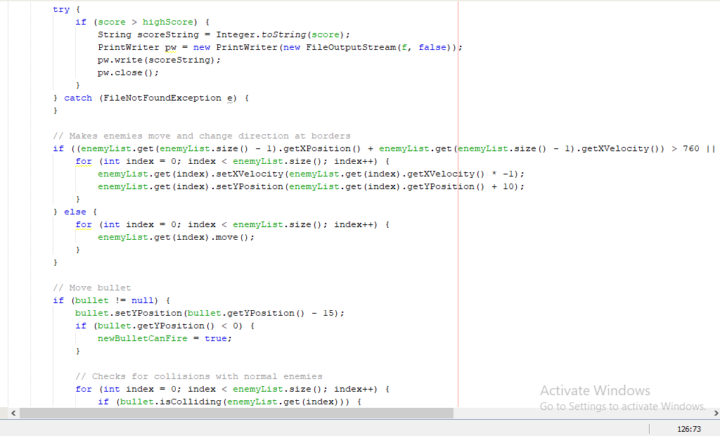
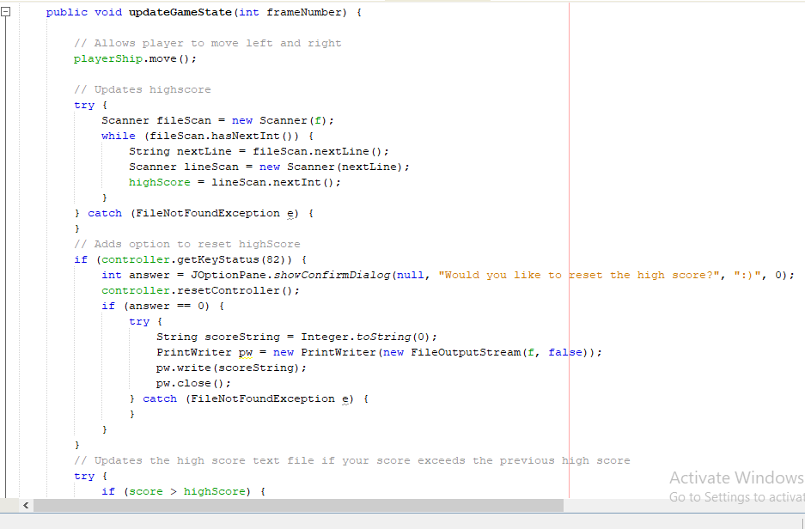
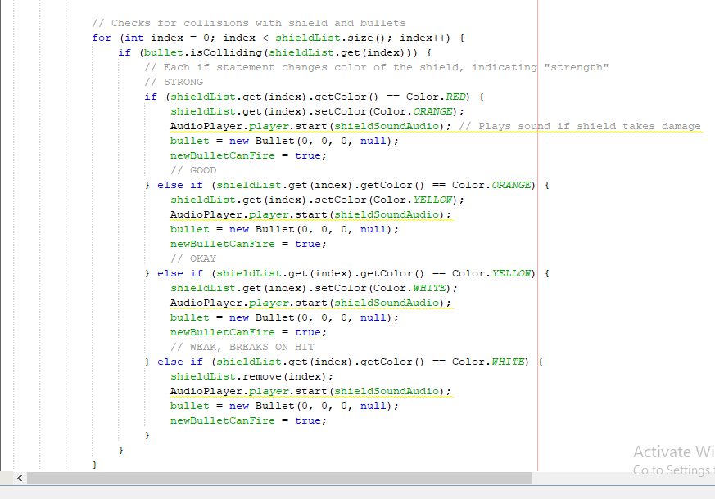
Game State Manager

Slide 17
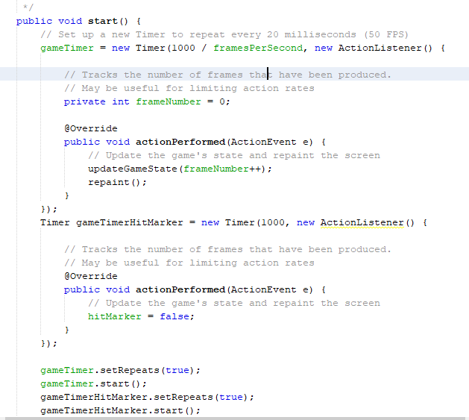
Animation

Slide 18
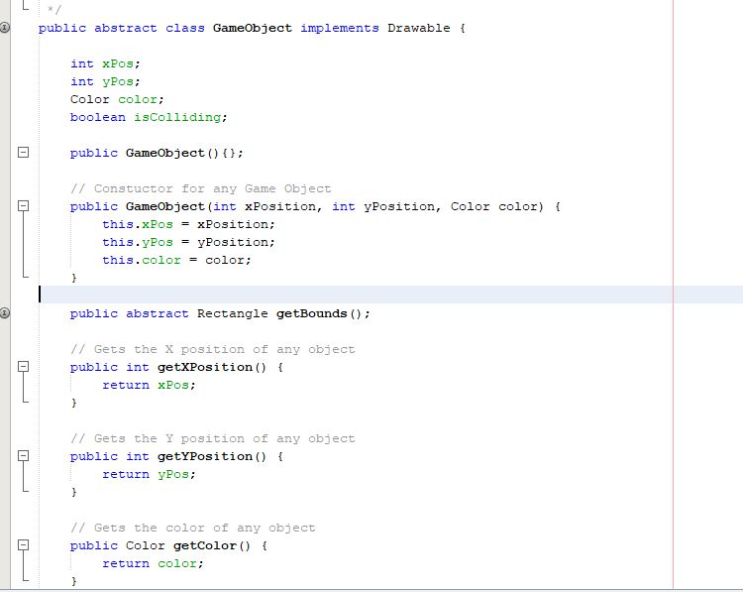
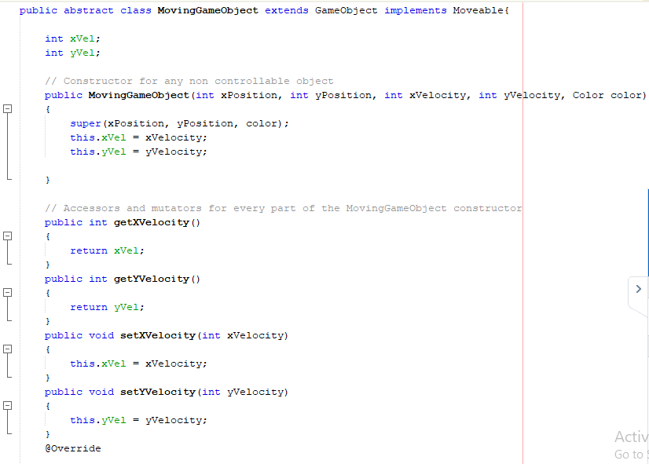
Entity

Slide 19
Resources
https://github.com/janbodnar/Java-Space-Invaders
https://github.com/piresjo/Java-Galaga
https://github.com/JoshuaCrotts/Generic-Space-Shooter

Slide 20

Members
Canilang, Romalee M.
Parro, Carl Jacob A.
Corpuz, Dylan Daniel O.
Rubin, Gary P.
Elegado, Thea Melaine C.

